Slide 1
Building School Family Relations
Presented By
Dr. Kirsten Robinson
TK Teacher - Bellflower Unified
CEO TRIFECTA NON-PROFIT

Slide 2
SESSION OVERVIEW… 5W1H
●THE WHO - INTRODUCTION AND PRESENTER CREDENTIALS
●THE WHY - LAYING A FOUNDATION FOR BUILDING A CONNECTION A GLIMPSE AT THE EDUCATORS CODE OF ETHICS AND EXPLORING THE DYNAMIC OF THE CHANGING FACE OF THE HOME
●THE WHAT - ESTABLISHING FOUR CLEAR COMMUNICATION GOALS
●THE WHERE - CONNECTING WITH SOURCE MATERIALS AND EXPERTS
●THE HOW - TAPPING DIGITAL RESOURCES, USING MOBILE DEVICES AND SOCIAL MEDIA
●THE WHEN - LAUNCHING YOUR OWN PROFESSIONAL LEGACY - NOW!

Slide 3
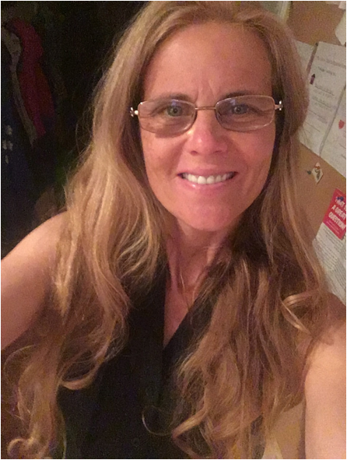
SUPER TEACHER’S BIO
·Associates in Communication Bachelors in Social Work Professional Clear Credential Masters in Education - emphasis Curriculum and Instruction Doctorate in Education - emphasis Instructional Leadership· Early Childhood Teaching Certificate ·
1993 Encoding, Processing and Retrieval Engineer Career Launch·taught in Compton, Long Beach , Cypress, Bellflower·
3rd,3rd/4th, K, 1st, K/1st, TK·
Mentor Teacher, Master Teacher, Adjunct College Professor, Professional Development Trainer·
Married16 years widowed 2005·
Adopted two brilliant boys at birth 2009 and 2010
Those who can do when those who should - teach!

Slide 4
ONCE UPON A TIME… THERE WAS THE FAMILY AND THEN...
somethng
broke and
we’ve been
trying to fix
it ever since….
Welcoming each child’s global village…
The birth of the Home Support Provider

Slide 5
Code of Ethics of the Education Profession
Preamble
The educator, believing in the worth and dignity of each human being, recognizes the supreme importance of the pursuit of truth, devotion to excellence, and the nurture of democratic principles.

Slide 6
Code of Ethics of the Education Profession
Preamble
Essential to these goals is the protection of freedom to learn and to teach and the guarantee of equal educational opportunity for all. A teacher recognizes the magnitude of the responsibility inherent in the teaching process.

Slide 7
Code of Ethics of the Education
Profession Principle 1
Commitment to the Student
Help each student realize his or her potential as a worthy and effective member of society stimulate the spirit of inquiry, the acquisition of knowledge and understanding, and the thoughtful formulation of worthy goals

Slide 8
Profession Principle 2
Commitment to the Profession
The education profession directly influences the nation and its citizens, the educator shall exert every effort to raise professional standards.

Slide 9
Code of Ethics and the Teacher’s OBLIGATION TO PARENTS????
The desire for the respect and confidence of one’s colleagues, of students, of parents, and of the members of the community provides the incentive to attain and maintain the highest possible degree of ethical conduct.

Slide 10
Communication Goal # 1
PARTICIPATION/CO-TEACH
Invite Home Support Providers into the realm of education and equip them with enough knowledge and assurance to participate in their child’s formal educational experience so as to help foster a universal climate of expectation and support that is conducive to success

Slide 11
Communication Goal # 2
INSPIRATION/INFLUENCE
Challenge Home Support Provider inertia and passivity with respect to the informal educational experiences that are optimal for building the student: mindsets, schema and schematics that will facilitate lifelong learning habits and collaborative relationships

Slide 12
Communication Goal # 3
ADVOCACY
Coax Home Support Providers into the community and politics of formal education, empower them to see the influence they have and the right they deserve to make their wishes, desires and dreams heard and known and their children’s needs met.

Slide 13
Sourcing Material
good resource for young teachers just getting started as well as teachers working with diverse groups of parents, grandparents, single parents, ELL parents, quite a few case studies are included, some of her work is considered offensive - become middle class, be like us, be alright...

Slide 14
Sourcing Material
Thought provoking analysis of generational poverty and its implications on educational achievement, insightful work on how students in different social-economic classes view the world, and how, as educators, we need to stand in the gaps and teach strategically

Slide 15
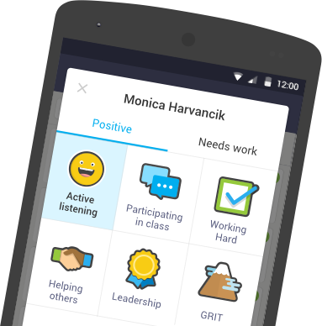
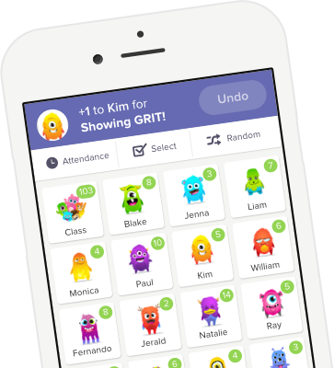
Techie Teacher Tools
Remind
https://www.remind.com/
ClassDojo
https://www.classdojo.com/

Slide 16
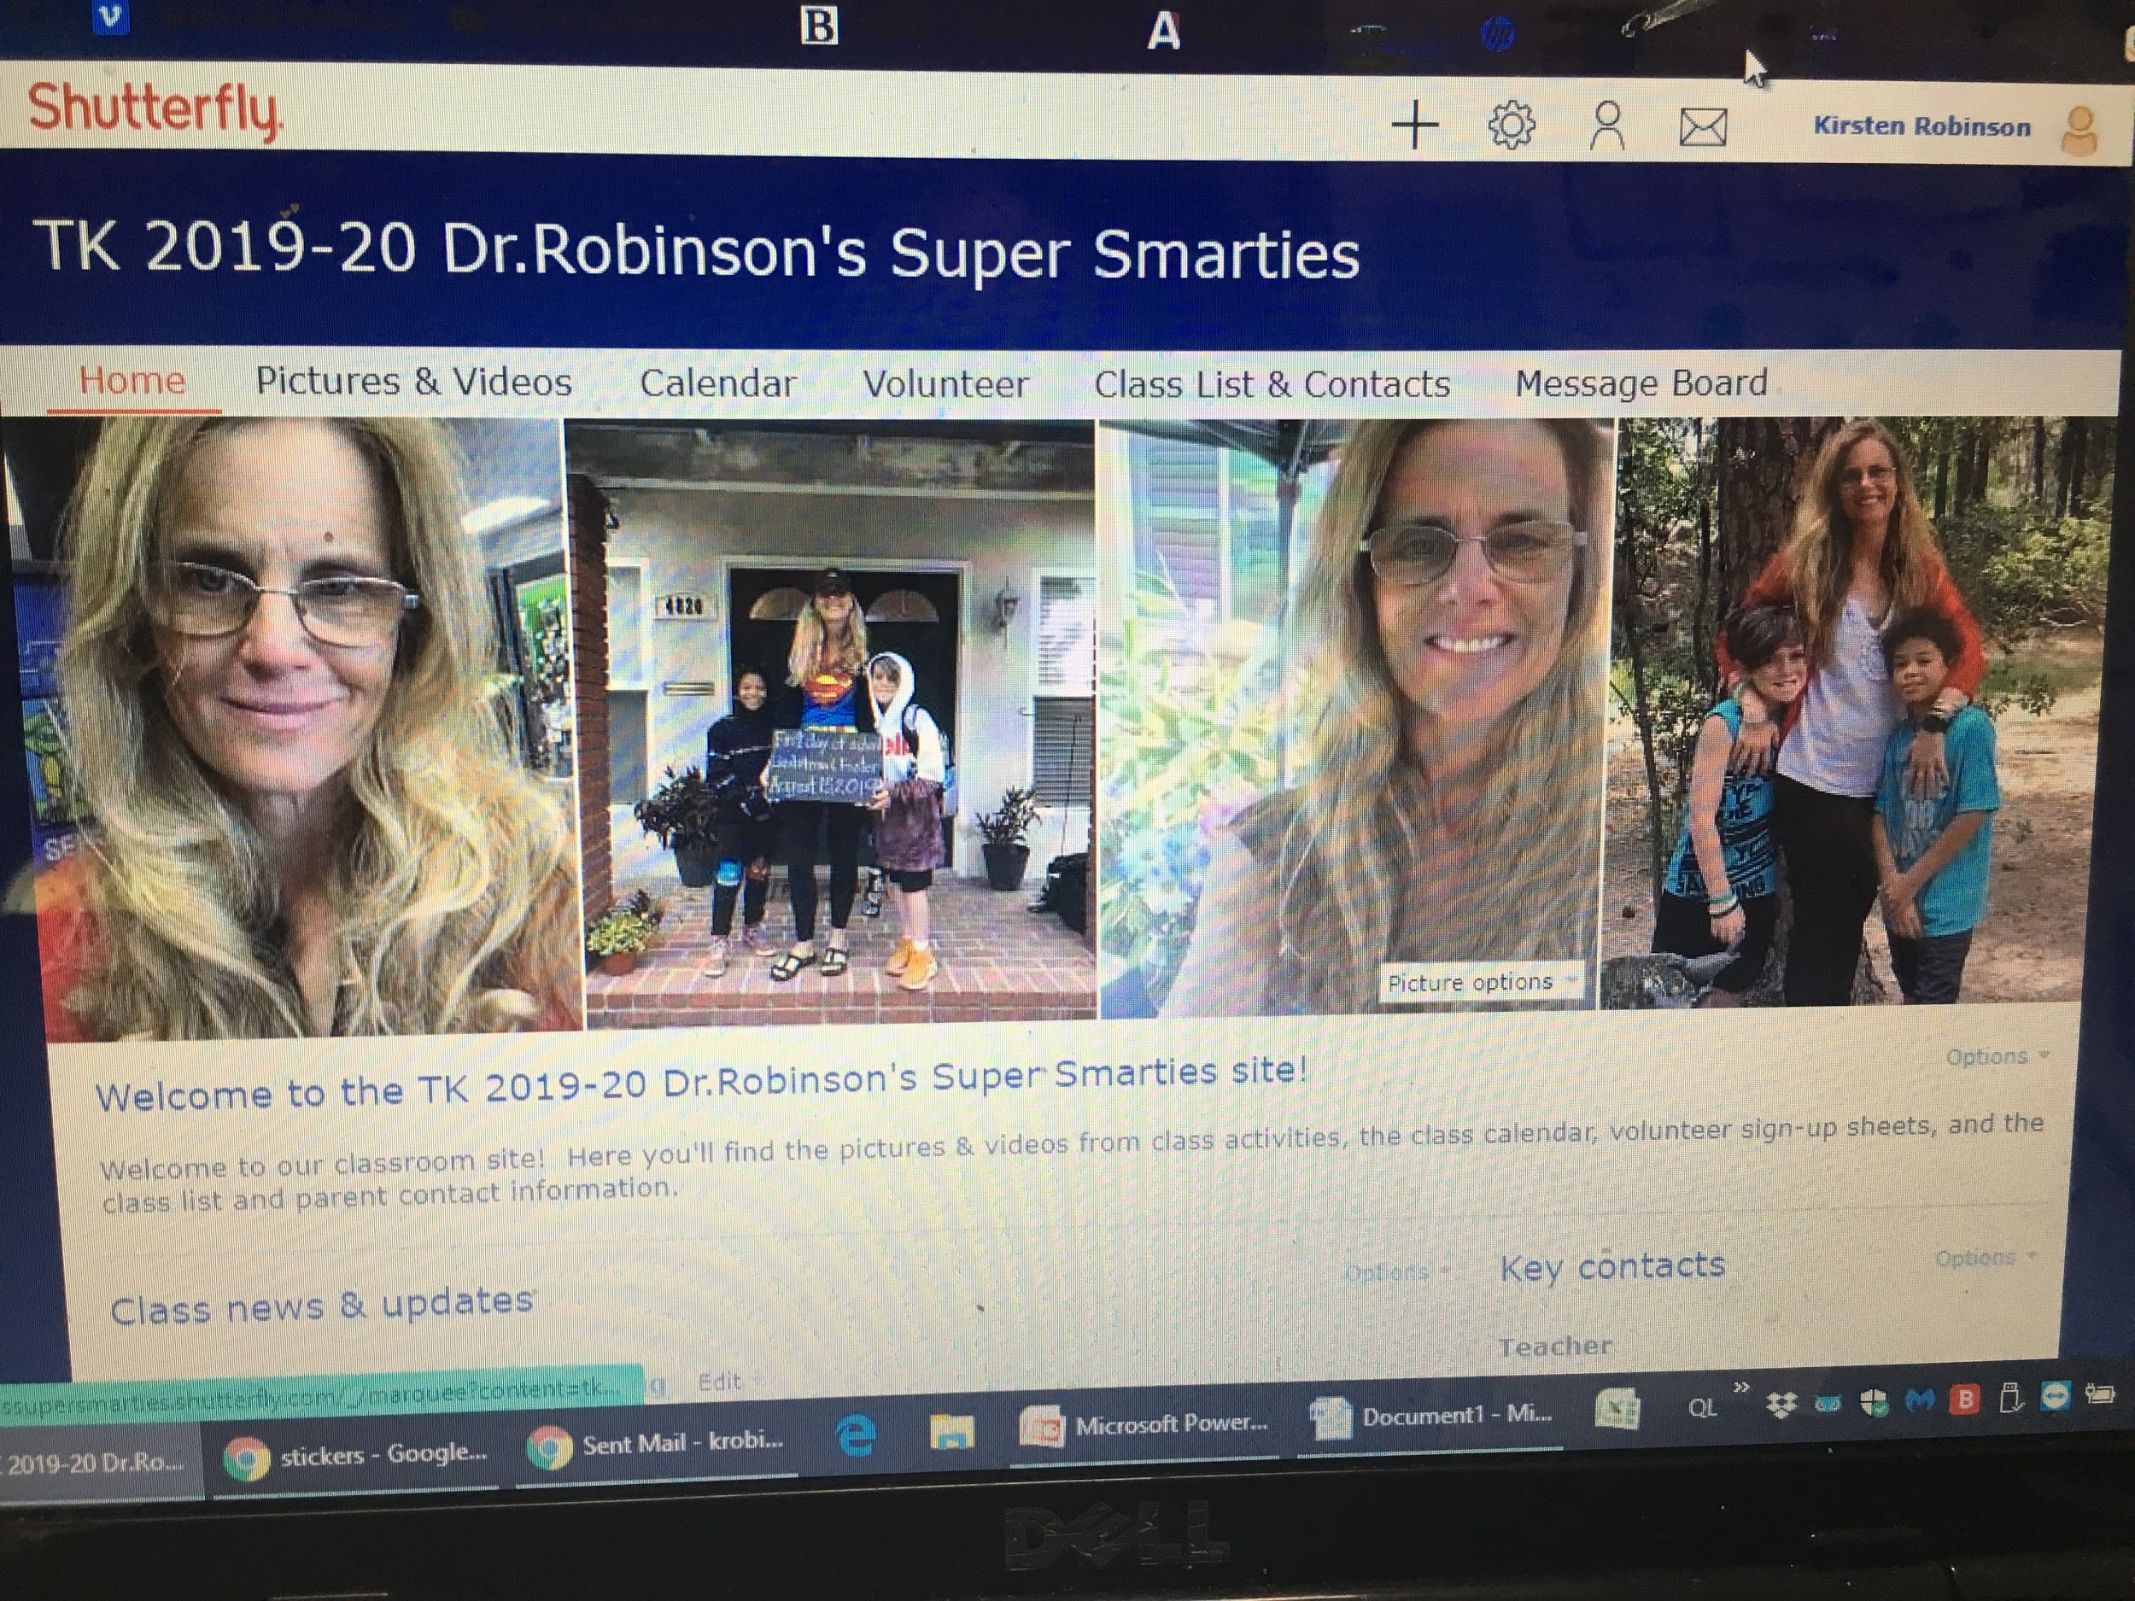
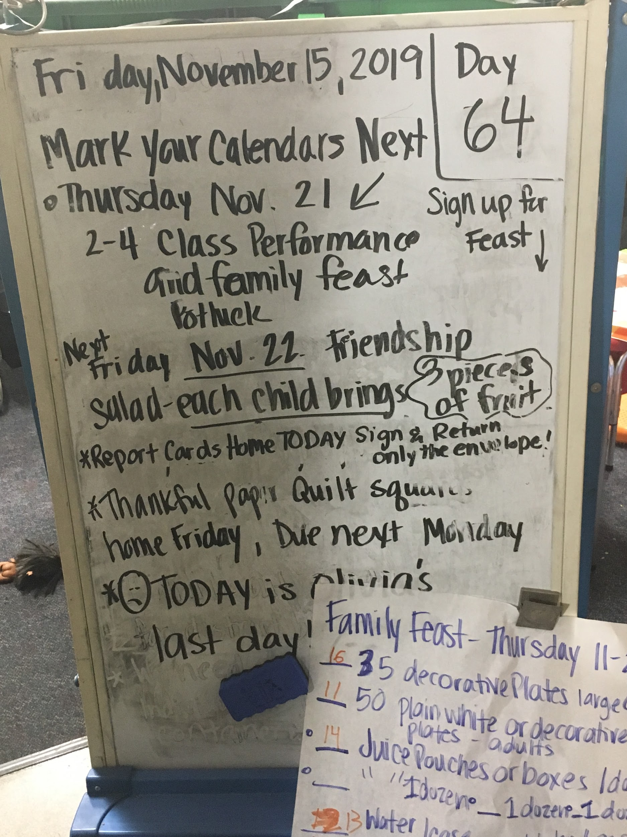
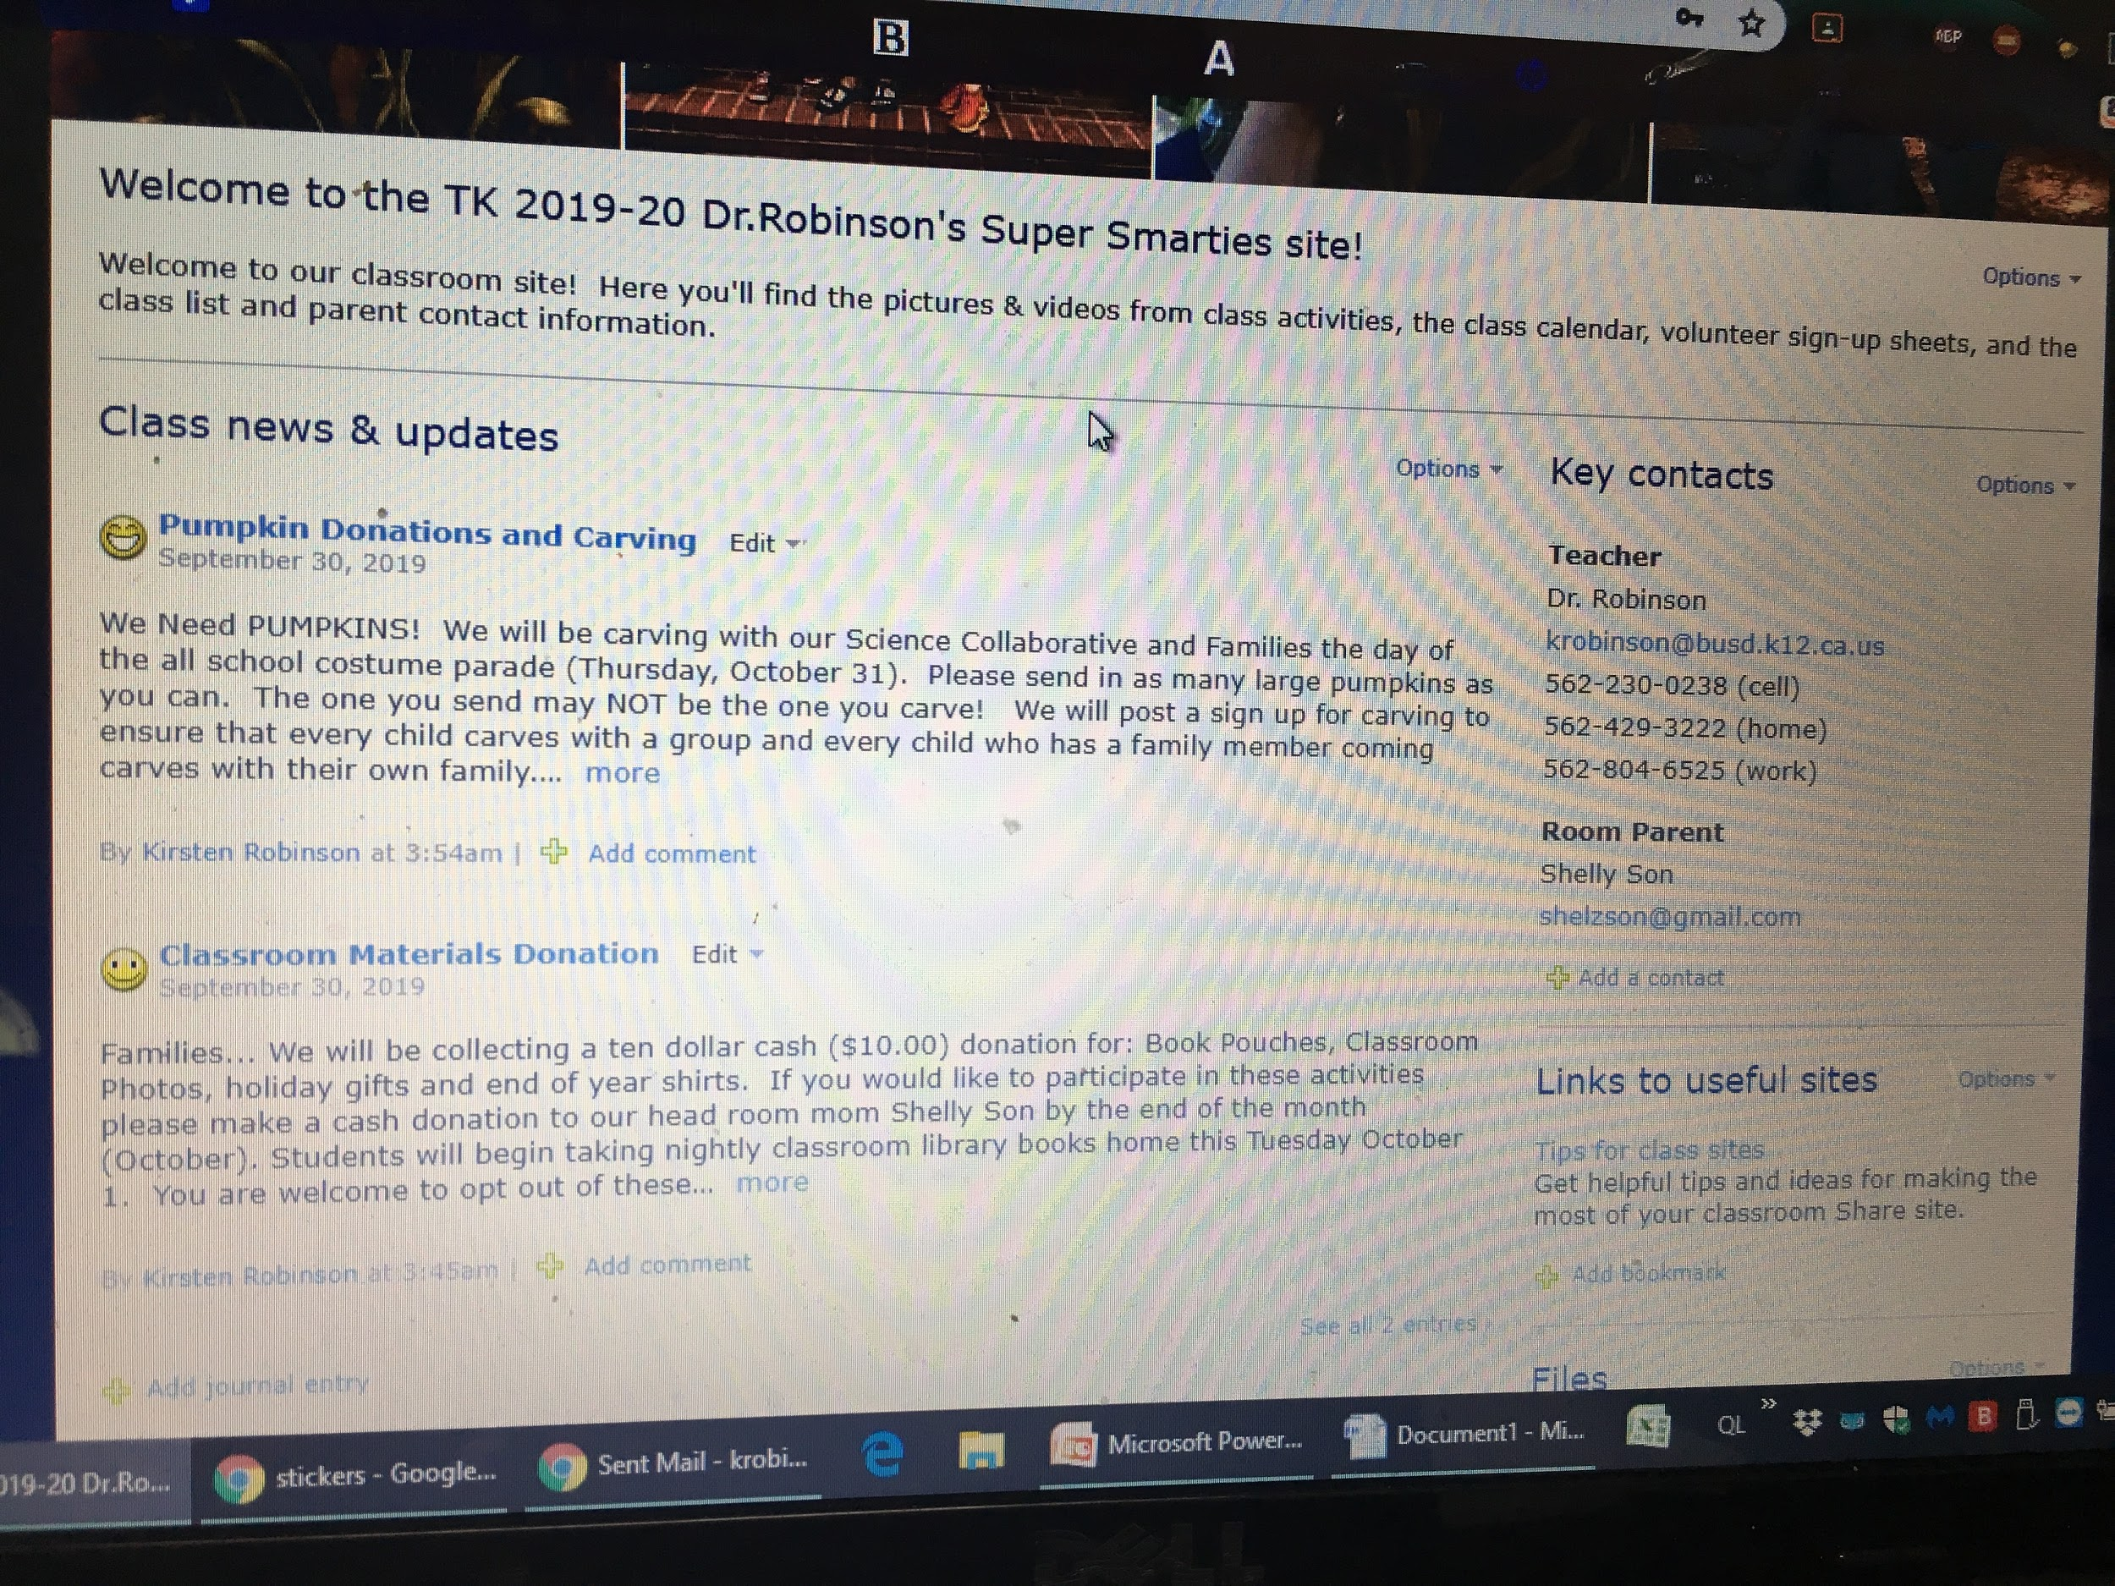
Shutterfly Free
Share Site
Class Information Board

Slide 17
Enter the Digital Age with Vimeo
Vimeo https://vimeo.com/

Slide 18
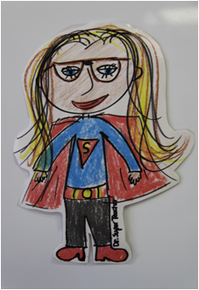
SESSION RECAP...
●COMMUNICATION GOAL 1-
PARTICIPATION/CO-TEACH
●COMMUNICATION GOAL 2-
INSPIRATION/INFLUENCE
●COMMUNICATION GOAL 3 -
ADVOCACY
●CONNECT WITH SOURCE MATERIALS & EXPERTS
●TAP RESOURCES IN THE DIGITAL AGE -
USE MOBILE DEVICES AND SOCIAL MEDIA
●EMBRACE YOUR LEGACY! BUILD YOUR LIFE TAPESTRY ONE THREAD AT A TIME AND ACCEPT
THAT YOU ARE ENOUGH!

